Slide 1
The Break a Record (BaR) Concept

Slide 2
What is the Break a Record (BaR) Concept?
The Break a Record (BaR) Concept is an innovative method used to improve performance by challenging the personal best.
It exploits the human reaction to challenge which states that when a pursuit is appraised as a challenge, we outperform.
The challenge is to Break a Record (Improve personal best), just for one time, during a Team building activity – a BaR Event

Slide 3
How does the BaR Concept Works?
Read and follow the BaR Rules
Organize a BaR Event at the workplace
Beat your personal best, just for once, during the BaR Event
Carry out the BaR Event and celebrate (with a piece of cake)
From the BaR Event identify the winning moves
Winning Moves are those actions/improvements that you have done so that the BaR Event was a success
Integrate the Winning Moves into the process so that the improvement is sustained
Share the knowledge with other teams

Slide 4
BaR Rules
Rule 1 - Engagement is Key, Empower the Team
Empower the team to find the barriers, do the actions and own the BaR Event
Rule 2 - Positive is Memorable
Create a positive experience
Rule 3 - Competition Killed the Cat
No competition. Improve personal best
Rule 4 - Learn and Share
Share learnings from the experience
Rule 5 - Recognition is free
No monetary recognition.. But sweets and cakes are accepted ☺
Rule 6 - Commitment is Sacred
If a date and target are set for the BaR Event, they are fixed and cannot be altered or changed

Slide 5
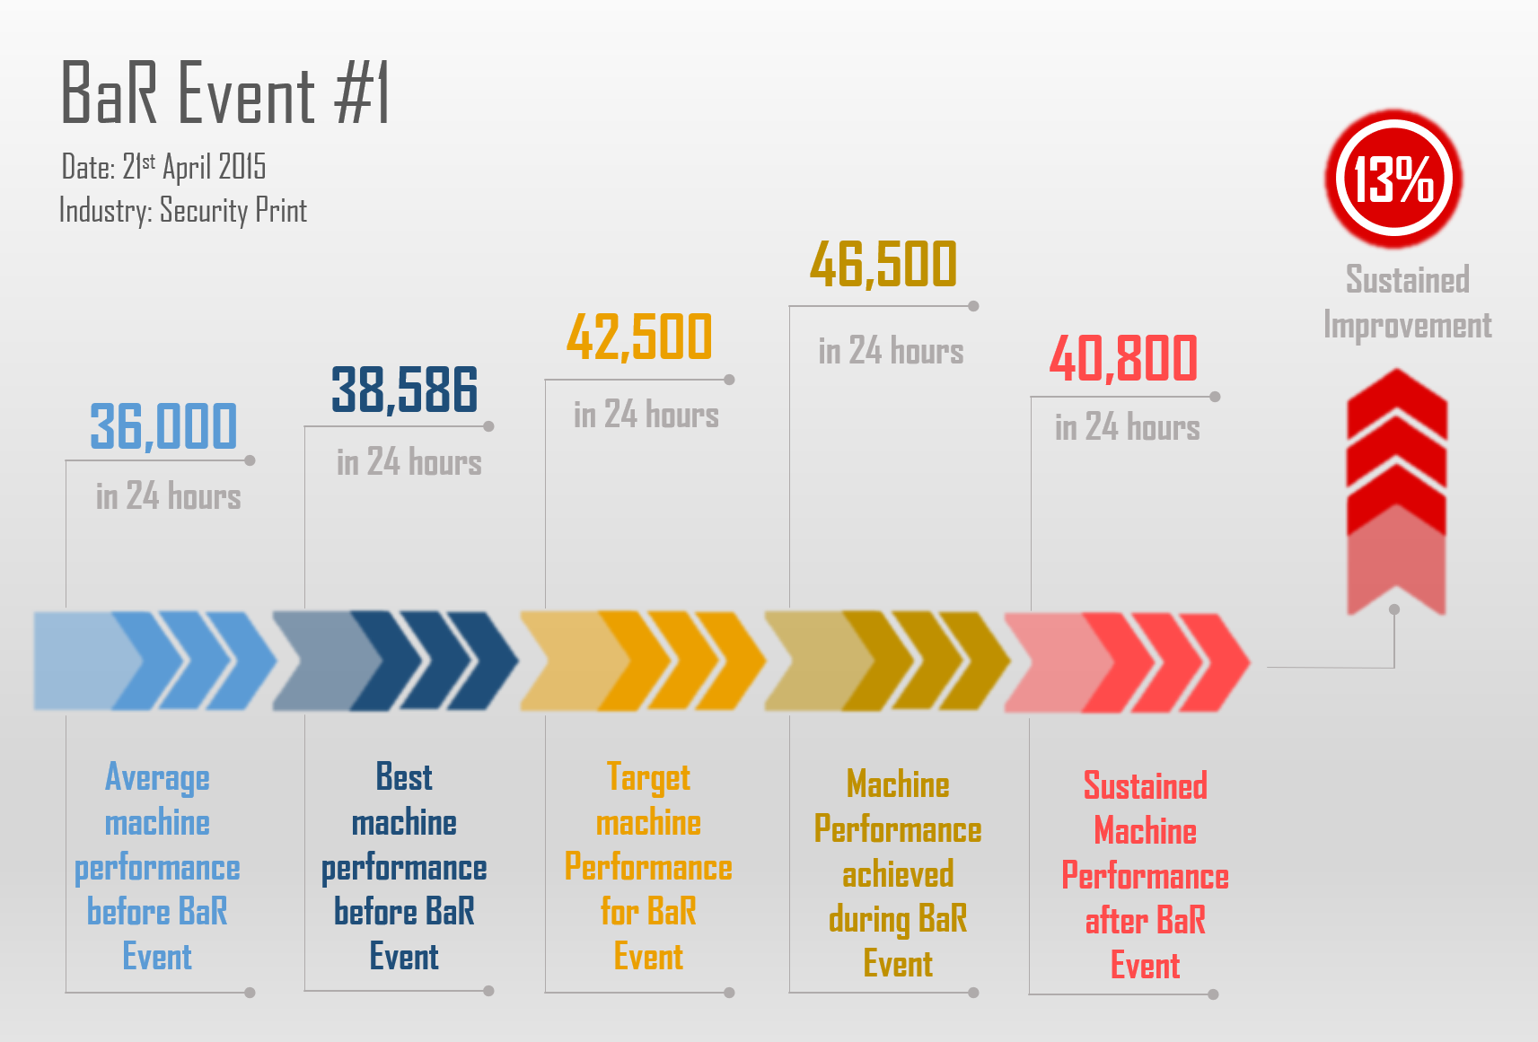
A typical BaR Event
Notes:
This BaR Event was the first ever recorded BaR Event. The event was done on a bottleneck machine, which has been problematic for years. The machine was manned on a 3 shift basis with 3 teams (one on each shift).
The average performance of the machine was around 36,000 pieces in 24 hours. The best that the teams have ever done was 38,586 pieces. Together with the team we agreed that the target for the BaR Event would be a 10% improvement on their personal best (therefore 10% on 38,586), that is 42,500 pieces in 24 hours. The BaR Team had 3 weeks to prepare for the BaR Event. They did the brainstorming sessions to identify the barriers and they took the necessary actions to remove the barriers.
They carried out the BaR Event and achieved 46,500 pieces in 24 hours (4,000 pieces more than the target, i.e. 10% more than the target, 20% more than personal best). This was an amazing achievement. Everyone was very proud and the engagement was amazing.
From the BaR Event, the BaR Team identified the winning moves which were integrated into the process. After integrating the improvements, the process sustained an average performance of 40,800 pieces a day, a 13% improvement over the pre BaR Event average performance. Apart from the performance, the engagement of the employees and the interaction between the 3 shifts (3 teams) improved dramatically.

Slide 6
Are you ready to take up the challenge?
Organize your
BaR Event

